Slide 1


Hermes
The Messenger
COP4331 – Fall 2021 – Group 3
Small Project: Contact Manager Website

Slide 2
Meet the team
Group 3 Presenters
Andrew Rodriguez: Backend Developer, API
Anthony Tran: Frontend Developer
Emmanuel Pineda: Backend Developer, Database
Kyle Mauter: Backend Developer, API
Helen Diaz: Frontend Developer, Project Manager

Slide 3


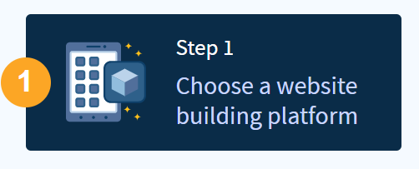



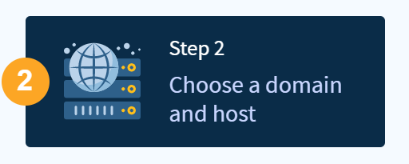

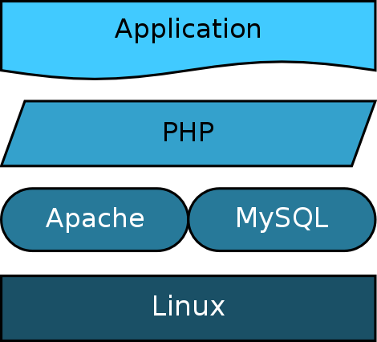

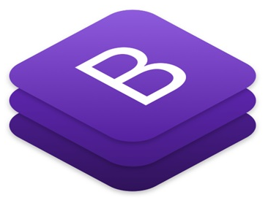





Contact Manager Website

Slide 4
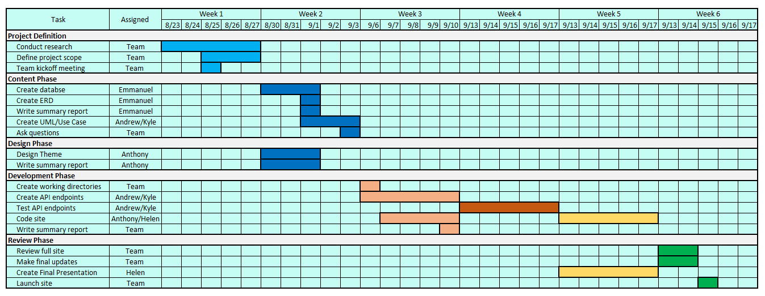
Gantt Chart

Slide 5
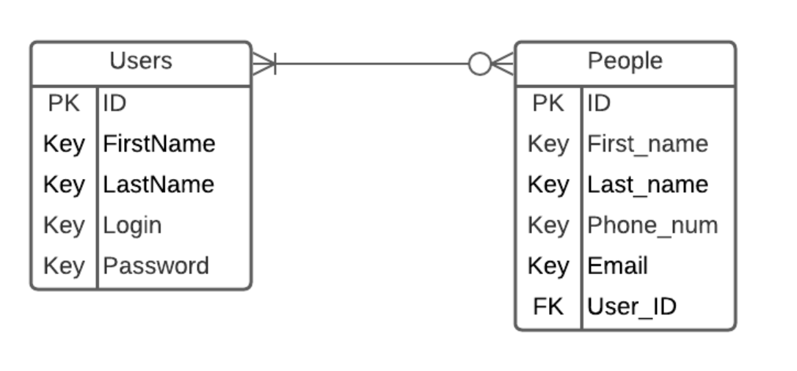
ERD

Slide 6
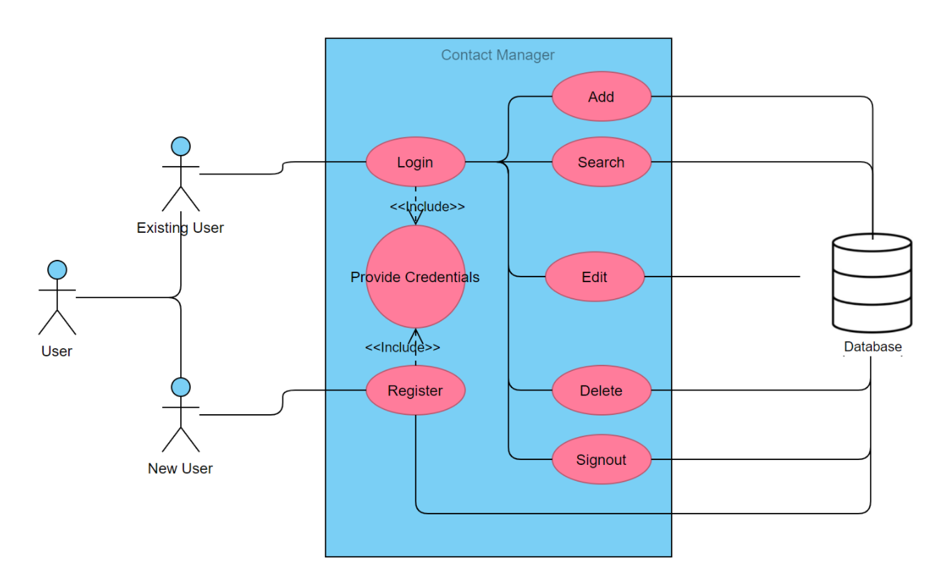
Use Case

Slide 7
Obstacles we overcame …
Defining project’s scope
Identify project requirements and deliverables
Testing APIs endpoints
Make changes to database
Debugging JavaScript files
Search/Edit APIs

Slide 8
Things that went VERY well!
Team Dynamics
Good communication
Shared goals and motivation
Adaptability and flexibility
Structure and clarity

Slide 9
Testing API endpoints

Slide 10
Hermes
The Messenger
http://small-Hermes.xyz

Slide 11

Time for Questions!
Unrestricted

Slide 12
Thank you !!!

